Slide 1
Applied Mechanism Design For Social Good
John P Dickerson
Lecture #12 – 3/4/2021
Lecture #13 – 3/9/2021
CMSC828M
Tuesdays & Thursdays
2:00pm – 3:15pm

Slide 2
Project Proposals
I’d like you to submit a 1-2 pager covering an initial plan for your course project by the end of next week (Fri March 12).
How to submit:
Make a channel on Slack (public or private)
Invite all group members + @John Dickerson
Upload the PDF of your initial course project plan
“@ me”
You will get 100% for this if you submit something “okay” – this is just to kickstart (i) movement and (ii) discussion between us

Slide 3

Project Proposals: A suggestion
Consider a 75%/100%/125% set of goalposts:
[Thanks, Aya Ismail! S2018 CMSC828M]

Slide 4
This class: Stackelberg & Security Games
Thanks to: AGT book, Conitzer (VC), Gupta (NG), Procaccia (AP)

Slide 5
Simultaneous Play
Previously, assumed players would play simultaneously
Two drivers simultaneously decide to go straight or divert
Two prisoners simultaneously defect or cooperate
Players simultaneously choose rock, paper, or scissors
Etc …
No knowledge of the other players’ chosen actions
What if we allow sequential action selection ...?

Slide 6
Leader-Follower Games
Two players:
The leader commits to acting in a specific way
The follower observes the leader’s mixed strategy
What is the Nash equilibrium ????????
Social welfare: 2
Utility to row player: 1
Row player = leader; what to do ????????
Social welfare: 3
Utility to row player: 2
Heinrich von Stackelberg
NE, iterated strict dominance
1, 1 | 3, 0
0, 0 | 2, 1
Commit to “Bottom”

Slide 7
Aside: First-mover Advantage (FMA)
From the econ side of things …
Leader is sometimes called the Market Leader
Some advantage allows a firm to move first:
Technological breakthrough via R&D
Buying up all assets at low price before market adjusts
By committing to a strategy (some amount of production), can effectively force other players’ hands.
Things we won’t model:
Significant cost of R&D, uncertainty over market demand, initial marketing costs, etc.
These can lead to Second-Mover Advantage
Atari vs Nintendo, MySpace (or earlier) vs Facebook

Slide 8
Commitment as an extensive-form game
1, 1 | 3, 0
0, 0 | 2, 1
For the case of committing to a pure strategy:
Player 1
Up
Down
Player 2
Player 2
Left
Right
Left
Right
1, 1
3, 0
0, 0
2, 1
VC

Slide 9
Commitment to mixed strategies
0
1
.49
1, 1 | 3, 0
0, 0 | 2, 1
.51
What should Column do ????????
Sometimes also called a Stackelberg (mixed) strategy
VC

Slide 10
Commitment as an extensive-form game…
For the case of committing to a mixed strategy:
Player 1
(1,0) (=Up)
(.5,.5)
(0,1) (=Down)
…
…
Player 2
Left
Right
Left
Right
Left
Right
1, 1
3, 0
.5, .5
2.5, .5
0, 0
2, 1
Economist: Just an extensive-form game …
Computer scientist: Infinite-size game! Representation matters
VC

Slide 11
What Should The Leader Commit tO?
2-P Z-S
Special case: 2-player zero-sum normal-form games
Recall: Row player plays Minimax strategy
Minimizes the maximum expected utility to the Col
Minimax utility: min_{σ-i} max_{si} u_{i}(s_{i}, σ_{-i})
Doesn’t matter who commits to what, when
Minimax strategies = Nash Equilibrium
= Stackelberg Equilibrium
(not the case for general games)
Polynomial time computation via LP – earlier lectures

Slide 12
What should the leader commit to?
2-P G-S
Strong Stackelberg Equilibrium (SSE): follower breaks ties in favor of the leader
Theorem [Conitzer & Sandholm]: In 2-player, general-sum normal-form games, an SSE can be found in polytime
?????????????
Idea:
Iterate over every follower pure strategy aka column c
Compute a mixed strategy r for leader such that playing pure strategy c is a best response for follower
Choose r*, the best (aka highest value for leader) mixed strategy amongst those strategies!
[Conitzer & Sandholm, Computing the optimal strategy to commit to, EC-06]

Slide 13
What should the leader commit to?
2-P G-S
Separate LP for every column c*:
maximize Σ_{r} p_{r} u_{R}(r, c*)
s.t.
for all c, Σ_{r} p_{r} u_{C}(r, c*) ≥ Σ_{r} p_{r} u_{C}(r, c)
Σ_{r} p_{r} = 1
for all r, p_{r} > 0
Choose strategy from LP with highest objective
Row utility
Column optimality aka Col best response
Distributional constraints
[Conitzer & Sandholm, Computing the optimal strategy to commit to, EC-06]

Slide 14
Running Example
1, 1 | 3, 0
0, 0 | 2, 1
x
y
maximize 1x + 0y
s.t.
1x + 0y ≥ 0x + 1y
x + y = 1
x ≥ 0
y ≥ 0
maximize 3x + 2y
s.t.
0x + 1y ≥ 1x + 0y
x + y = 1
x ≥ 0
y ≥ 0
VC

Slide 15
Is Commitment always good for the leader?
Yes, if we allow commitment to mixed strategies
Always weakly better to commit [von Stengel & Zamir, 2004] ??????
If (r*, c) is Nash, then Row can always commit to r* → Col will play c*, can achieve value of that equilibrium
What about only pure strategies?
Expected utility to Row by playing mixed Nash:
???????????
 | Rock | Paper | Scissors
Rock | 0,0 | -1,+1 | +1,-1
Paper | +1,-1 | 0,0 | -1,+1
Scissors | -1,+1 | +1,-1 | 0,0
E_{R}[ <1/3,1/3,1/3> ] = 0
Expected utility to Row by any pure commitment:
???????????
E_{R}[ <1,0,0> ] = -1
E_{R}[ <0,1,0> ] = -1
E_{R}[ <0,0,1> ] = -1

Slide 16
What should the leader commit to?
Bayesian 2-P G-S
Bayesian games: player i draws type θ_{i} from Θ
Special case: follower has only one type, leader has type θ
Like before, solve a separate LP for every column c*:
maximize Σ_{θ} π(θ) Σ_{r} p_{r,θ} u_{R,θ}(r, c*)
s.t.
for all c, Σ_{θ} π(θ) Σ_{r} p_{r,θ} u_{C}(r, c*) ≥ Σ_{θ} π(θ) Σ_{r} p_{r,θ} u_{C}(r, c)
for all θ, Σ_{r} p_{r,θ} = 1
for all r,θ, p_{r,θ} > 0
Choose strategy from LP with highest objective

Slide 17
What should the leader commit to?
Bayesian N-P G-S
So, we showed polynomial-time methods for:
2-Player, zero-sum
2-Player, general-sum
2-Player, general-sum, Bayesian with 1-type follower
In general, NP-hard to compute:
2-Player, general-sum, Bayesian with 1-type leader
Arguably more interesting (“I know my own type”)
2-Player, general-sum, Bayesian general
N-Player, for N > 2:
1st player commits, N-1-Player leader-follower game, 2nd player commits, recurse until 2-Player leader-follower

Slide 18
Stackelberg Security Games
Leader-follower → Defender-attacker
Defender is interested in protecting a set of targets
Attacker wants to attack the targets
The defender is endowed with a set of resources
Resources protect the targets and prevent attacks
Utilities:
Defender receives positive utility for preventing attacks, negative utility for “successful” attacks
Attacker: positive utility for successful attacks, negative otherwise
Not necessarily zero-sum

Slide 19
Security Games: A Formal Model
Defined by a 3-tuple (N, U, M):
N: set of n targets
U: utilities associated with defender and attacker
M: all subsets of targets that can be simultaneously defended by deployments of resources
A schedule S ⊆ 2^{N} is the set of target defended by a single resource r
Assignment function A : R → 2^{S} is the set of all schedules a specific resource can support
Then we have m pure strategies, assigning resources such that the union of their target coverage is in M
Utility u_{c,d}(i) and u_{u,d}(i) for the defender when target i is attacked and is covered or defended, respectively

Slide 20
Simple Example
Resources
Targets
1
R
2
Targets
Defender
Attacker Type θ₁
Attacker Type θ₂
i | u_{c,d}(i) | u_{u,d}(i) | u_{c,a}(i) | u_{u,a}(i) | u_{c,a}(i) | u_{u,a}(i)
1 | 0 | -1 | 0 | +1 | 0 | +1
2 | 0 | -2 | 0 | +5 | 0 | +1
[Blum, Haghtalab, Procaccia, Learning to Play Stackelberg Security Games, 2016]

Slide 21
Real-world Security Games
Lots of deployed applications!
Checkpoints at airports
Patrol routes in harbors
Scheduling Federal Air Marshalls
Patrol routes for anti-poachers
Typically solve for strong Stackelberg Equilibria:
Tie break in favor of the defender; always exists
Can often “nudge” the adversary in practice
Two big practical problems: computation and uncertainty

Slide 22
Overview of an impactful paper in this space
[Kiekintveld et al. 2009]
Computing Optimal Randomized Resource Allocations for Massive Security Games (linked on course webpage)
Motivated first by resource assignment for checkpoints at LAX, e.g., multiple canine units assigned to cover multiple terminals …
… and later by much larger games such as Federal Air Marshals Service assignments and port inspection.
m resources to cover n targets, m < n
Defender (leader) commits to a mixed strategy
Attacker (follower) observes the probabilities for each coverage set
Surveillance, insider threat, etc – maybe not perfectly realistic
Attacker chooses a pure strategy
Equilibrium concept not ex post

Slide 23
Overview of an impactful paper in this space
[Kiekintveld et al. 2009]
Initially assume interchangeable resources (extended in paper, will cover in a few slides by introducing “types”)
Assume players are risk neutral
One type of follower (attacker)
Recall: one type of follower → PTIME solvable, one LP solved for each pure strategy of follower …
… but the number of pure strategies in some games might be large, e.g., with 100 targets and 10 resources, 1.7 x 10¹³!

Slide 24

Running Example
4 targets, 2 resources
Qualitatively:
Defender values all 4 targets equally (and prefers a covered attack to an uncovered attack).
Attacker gets twice as much utility for successful attack on target 3. All failed attacks get the same (lower) utility.
1
2
3
4
NG

Slide 25
Motivation and introduction
“Utility for leader θ if the target 3 is attacked and it is covered (c) or uncovered (u)”
1
2
3
4
Targets {1, 2, 4}
 |  | Covered | Uncovered
Defender |  | 4 | 1
Attacker |  | 0 | 1
Target 3
 | Covered | Uncovered
Defender | 4 | 1
Attacker | 0 | 2
“Utility for follower Ψ if attacks target 3 and it is covered (c) / uncovered (u)”

Slide 26
Compact Representations of Security Games—Extensive Form is Too Big!
Defender commits to a mixed strategy (one of uncountably many, i.e., EFG tree will be infinite size)
Attacker strategy is an efficient algorithm, which given any mixed strategy, Δ, computes target
Where optimization is taken over the attack set Γ(Δ), the set of targets yielding max expected payoff for attacker given Δ
In general, size

Slide 27
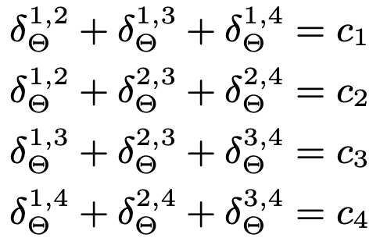
Compact Representations of Security Games
Key insight: the only information needed to represent the defender strategy is the probabilities a target is covered
This gives us a coverage vector C
Running example: C = [c₁, c₂, c₃, c₄]
ERASER (Efficient Randomized Allocation of SEcurity Resources) takes security game & computes C that is SSE for defender
In our 2 resources, 4 targets example: probability c₁ that target 1 is covered is sum of all pure strategies that cover 1

Slide 28
ERASER Formulation
Attacker can assign mass to exactly one target
Defender applies valid (aka at most m) probability mass over targets
(Theorem in paper states how to convert coverage vector to mixed strategy)

Slide 29
ERASER Formulation
Determine the defender’s expected payoff d, given the target attacked (a_{t})
For unattacked targets (a_{t}=0), RHS is huge (i.e., Z)
For attacked target (a_{t}=1), RHS is 0 → d = utility of defender given t attacked, and coverage vector C
Objective: maximize d
Expected utility to leader given attack on t and coverage vector with coverage c_{t}

Slide 30
ERASER Formulation
Two bottom sets of constraints imply that defender’s coverage vector C is best response to attack vector A, & vice versa
→ Strong Stackelberg Equilibrium
“Big M” (or in this case “Big Z”) style of constraints are a common way to encode if statements

Slide 31
ERASER: Running Example (2 Resources, 4 targets)
NG

Slide 32
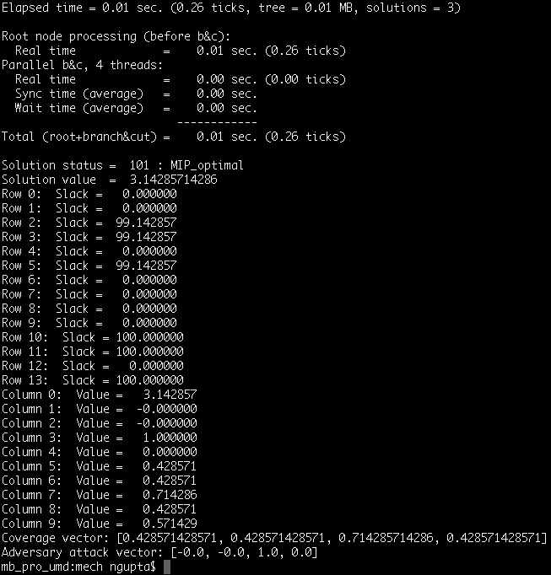
ERASER: Running Example (2 Resources, 4 targets)
NG

Slide 33
ERASER – running example
Problem: we need mixture over pure strategies (i.e., placements of resources on targets), not just coverage vector
NG

Slide 34
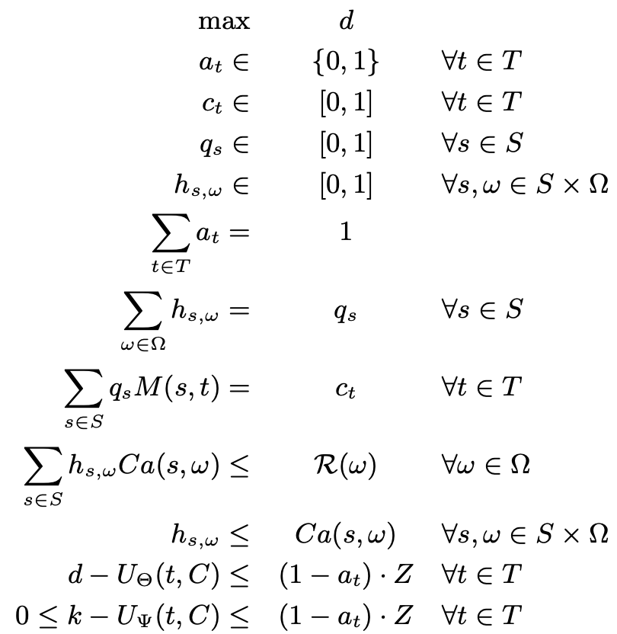
ERASER-C(Onstrained)
Can generalize to a setting where resources have a type drawn from some type space Ω
Type ω in Ω determines feasible coverage schedules, i.e., subsets of targets coverable by that resource
Yields a very similar compact IP, similar solution of probability mass placed on each resource and schedule

Slide 35
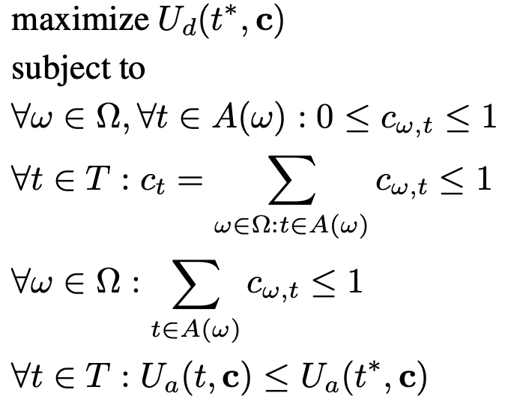
How to compute the actual mixed strategy to follow?
Kiekintveld paper proved feasible solutions (i.e., coverage vectors) to their MIPs corresponded to mixed strategies
Did not show how to compute them quickly ( variables δ_{ω,t})
First idea: for each target t*:
Solve separate compact LP under the constraint that the attacker is incentivized to attack t*
Pick LP with best defender utility
Just like last lecture!
Problem: this still gives marginal probabilities over targets
We need probability mixture over pure strategies!

Slide 36
A tool: Birkhoff-von Neumann theorem
Every doubly stochastic n x n matrix can be represented as a convex combination of n x n permutation matrices
Decomposition can be found in polynomial time O(n^{4.5}), and the size is O(n²) [Dulmage and Halperin, 1955]
Can be extended to rectangular doubly substochastic matrices
.1 | .4 | .5
.3 | .5 | .2
.6 | .1 | .3
1 | 0 | 0
0 | 0 | 1
0 | 1 | 0
0 | 1 | 0
0 | 0 | 1
1 | 0 | 0
0 | 0 | 1
0 | 1 | 0
1 | 0 | 0
0 | 1 | 0
1 | 0 | 0
0 | 0 | 1
= .1
+.1
+.5
+.3
Notes:
A substochastic matrix is a square matrix Q with nonnegative entries so that every row adds up to at most 1.

Slide 37
Schedules of size 1 using BvN
“Schedule of size 1” → resource is assigned to exactly one target
ω ₁
.7
t₁
.1
.2
 | t₁ | t₂ | t₃
ω₁ | .7 | .2 | .1
ω₂ | 0 | .3 | .7
.3
t₂
ω ₂
.7
t₃
.1
.2
.2
.5
0 | 0 | 1
0 | 1 | 0
0 | 1 | 0
0 | 0 | 1
1 | 0 | 0
0 | 1 | 0
1 | 0 | 0
0 | 0 | 1

Slide 38
Counter-example to the compact LP
ω₂
.5
.5
.5
t
t
ω₁
.5
t
t
2 resources ω₁ & ω₂, schedules of size 2
LP suggests: we can cover every target with probability 1 ?????
… but in fact we can cover at most 3 targets at a time → for general schedule sizes, it is not always possible to find feasible mixture
VC

Slide 39
Algorithms & complexity
[Korzhyk, Conitzer, Parr, “Complexity of Computing Optimal Stackelberg Strategies in Security Resource Allocation Games]
 |  | Homogeneous Resources | Heterogeneous resources
Schedules | Size 1 | P | P (BvN theorem)
 | Size ≤2, bipartite
 | Size ≤2
 | Size ≥3
P
(BvN theorem)
NP-hard
(SAT)
P
(constraint generation)
NP-hard
NP-hard
(3-COVER)
NP-hard

